Slide 1



Sustainable Supply Chain: from Metrics to Impact
By
(Presenter Name)
In partial fulfillment of the requirements of the degree of
Associate Professor
College of ………………………………
Arab Academy for Science, Technology and Maritime Transport (AASTMT)

Slide 2
Agenda
01
02
03
04
05
06
07
08
Supply Chain Sustainability Management
The Importance of Measuring Supply Chain Sustainability Performance
Supply Chain Sustainability Performance Items
Egypt’s Sustainability Performance Rankings
Most-Discussed Research Topics Impacting Sustainability Performance Management (2024–2025)
Contributions
Future Research Directions
Contemporary Sustainable Practices in Supply Chain Management

Slide 3
Supply Chain Sustainability Management
The UN Sustainable Development Goals (SDGs), launched in 2015, set a global sustainability framework until 2030.
Supply Chain Sustainability Management (SCSM) integrates environmental, social, and economic objectives into supply chain strategy to foster resilience and sustainability (Carter & Rogers, 2008; Al‑Okaily et al., 2024).
It aims to protect the environment, ensure fair working conditions, and support long-term economic growth.
Notes:
Economic resilience aims to better prepare regions to anticipate, withstand, and bounce back from any type of shock, disruption, or stress it may experience.

Slide 4

The Importance of Measuring Supply Chain Sustainability Performance
Growing sustainability awareness pressures firms to adopt and prove sustainable practices.
Performance evaluation helps track progress, improve decisions, and stay competitive.
Assessing supply chain sustainability ensures goal achievement, improvement, and transparent reporting.

Slide 5

Supply Chain Sustainability Performance Items
Environmental Performance Measurement (Marrucci, Daddi, & Iraldo, 2024) | Social Performance Measurements (Kumar & Anbanandam, 2022) | Economic Performance Measurements, (Damtoft et al, 2025)
Carbon Footprint: Greenhouse Gas Emissions. | Labour conditions include fair salaries, working hours, and safe work environments. | Cost Savings: Enhancements in efficiency that lower expenses.
Waste Management: Reduction, Recycling, and Disposal Techniques. | Community engagement involves positive contributions to local communities. | Long-Term Profitability: Harmonizing sustainability with financial performance.
Energy Usage: Renewable and Non-renewable Energy Sources. | Human rights compliance prevents forced labour and discrimination. | Innovation: Creating new sustainable products and processes.
Water Usage: Efficiency and impact on local water resources.

Slide 6
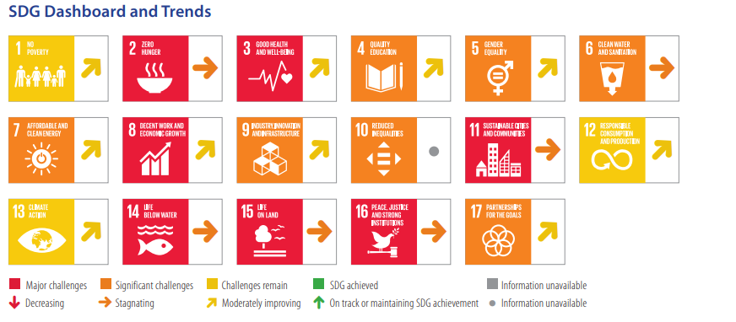
Egypt’s Sustainability Performance Rankings
Index Name | Latest Year | Latest Rank | Previous Year | Previous Rank | Key Notes
Climate Change Performance Index (CCPI) | 2025 | 20th out of 67 | 2024 | 22nd out of 67 | Egypt is good at controlling greenhouse gas emissions and using energy efficiently, but it is still not using enough renewable energy.
Environmental Performance Index (EPI) | 2024 | 101st out of 180 | 2022 | 118th out of 180 | Egypt is doing well in protecting natural environments, but it is still weak in areas like protecting the sea, controlling pollution, and treating wastewater properly.
Sustainable Development Goals Index (SDG Index) | 2025 | 91st out of 167 | 2024 | 83rd out of 166 | Tracks progress on the 17 UN Sustainable Development Goals.
Notes:
Economic Viability : if the project benefits exceed the project costs.

Slide 7
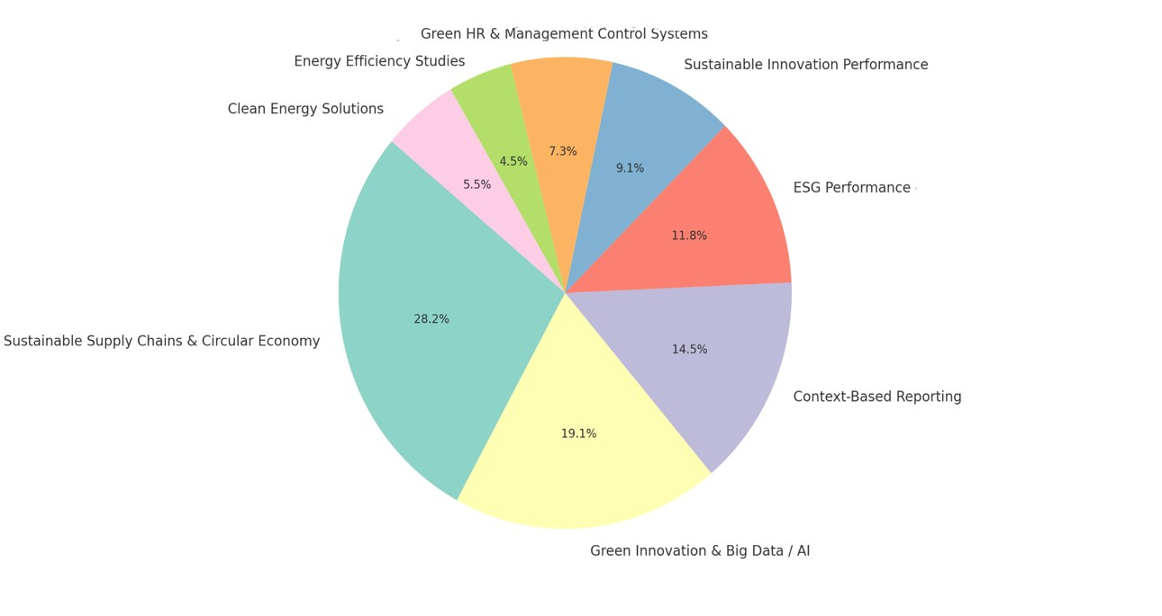
Most-Discussed Research Topics Impacting Sustainability Performance Management (2024–2025)
Note: The data presented in this figure were extracted exclusively from articles indexed in the Web of Science and Scopus databases.
Notes:
Economic Viability : if the project benefits exceed the project costs.
Total 3577
Scopus 2904
WOS 988
Duplicated 478 (239)
Total 3653

Slide 8
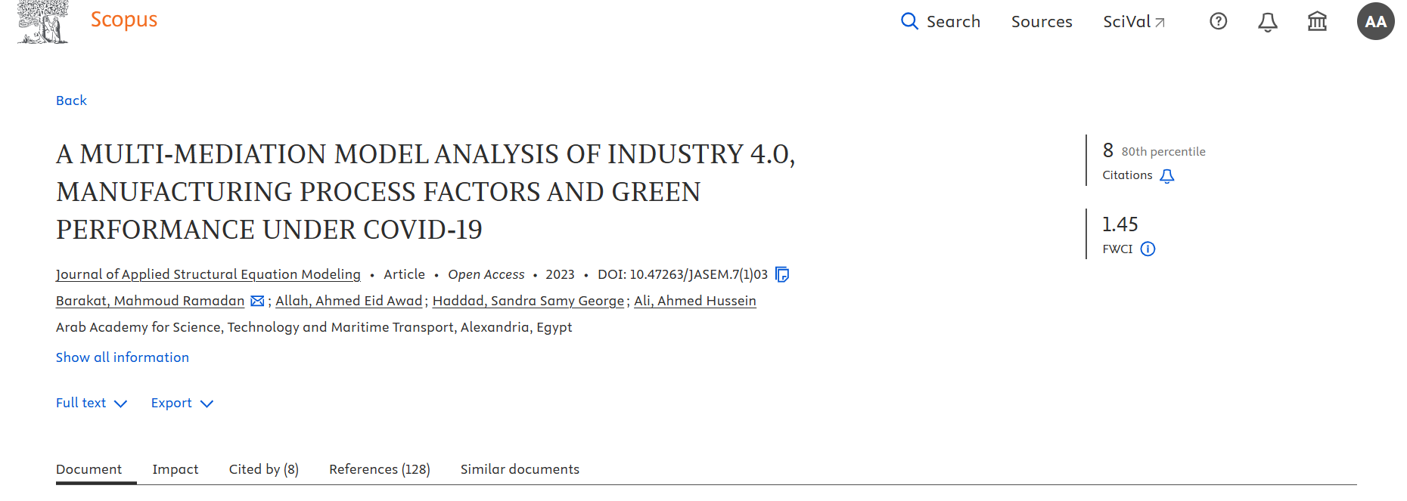
Contributions
Journal: Journal of Applied Structural Equation Modeling (SCOPUS Q1 ) 2023
Contribution: extending Resource Dependency Theory within a novel empirical context, particularly in relation to how firms in developing countries can maintain green practices among external disruptions. The study provides practical insights for manufacturers seeking to integrate lean manufacturing principles with I4.0 technologies to enhance environmental performance. Moreover, it addresses a gap in the literature by examining the dynamic interaction between I4.0, lean manufacturing, and green performance during periods of market instability, such as those induced by the COVID-19 pandemic.
A Multi-mediation Model Analysis Of Industry 4.0, Manufacturing Process Factors and Green Performance under Covid-19

Slide 9
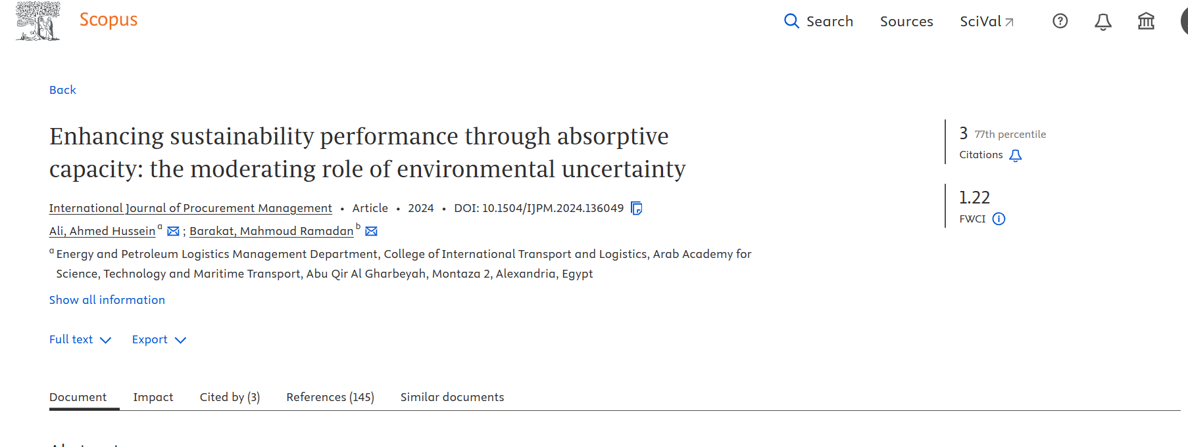
Contributions
Journal: International journal of procurement management (SCOPUS Q3) 2024
Enhancing Sustainability Performance Through
Absorptive Capacity: The Moderating Role of
Environmental Uncertainty
Contribution: This study provides theoretical and practical contributions by advancing stakeholder theory and the knowledge-based view (KBV) through exploring the role of absorptive capacity in enhancing sustainability performance within dynamic environments. By introducing environmental uncertainty as a moderating factor, the research offers a deeper understanding of how organizations can leverage knowledge sharing and stakeholder collaboration to improve sustainable outcomes. Practically, the study guides managers and policy makers on how to strengthen sustainability practices, foster innovation, and build resilient supply chains, especially in developing countries.

Slide 10
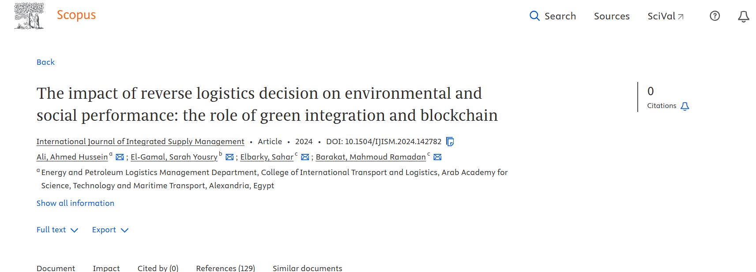
Contributions
Journal: International Journal of Integrated Supply Management (SCOPUS Q2) 2024
The Impact of Reverse Logistics Decision on
Environmental and Social Performance: The Role of
Green Integration and Block-chain
Contribution: extension of Resource based view (RBV) theory by incorporating digital technologies, such as block-chain, into reverse logistics processes. It offers practical insights for decision-makers and policymakers on how combining reverse logistics with block-chain can enhance environmental and social performance in developing country contexts like Egypt.

Slide 11
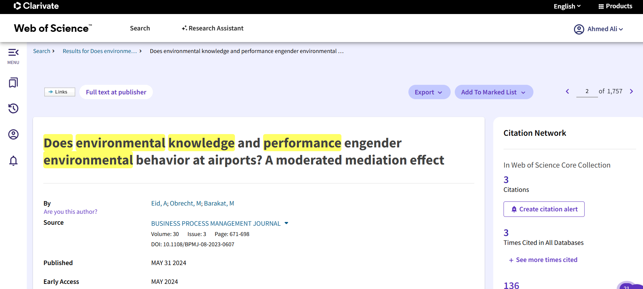
Contributions
Journal: Business Process Management Journal (SCOPUS Q1- Wos Q1) 2024
Does Environmental Knowledge and Performance Engender Environmental Behaviour at Airports? A Moderated Mediation Effect
Contribution: This study contributes theoretically by extending the Theory of Reasoned Action (TRA) to North African airports, integrating environmental knowledge, attitudes, advertising, and sustainability performance into a comprehensive model of environmental behaviour (EB). It shifts the focus to individual behaviours within airports. Practically, it offers a framework and guidelines to help airport authorities and stakeholders improve environmental behaviour, enhance sustainability, and address key environmental challenges in the region.

Slide 12
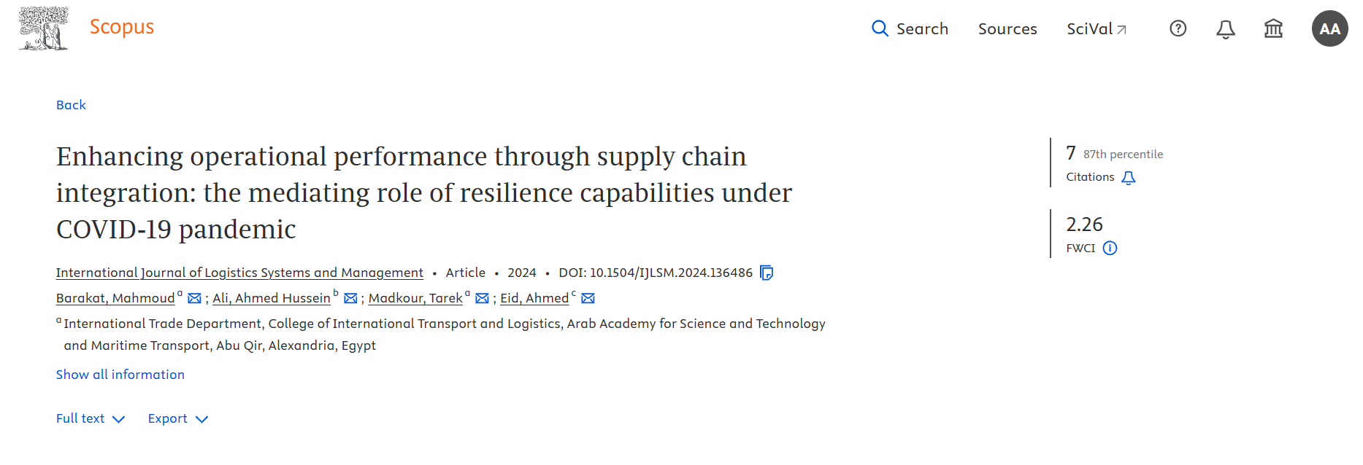
Contributions
Journal: International Journal of Logistics Systems and Management (SCOPUS Q3) 2024
Enhancing Operational Performance through Supply Chain Integration: The Mediating Role of Resilience Capabilities under COVID-19 Pandemic
Contribution: The contribution lies in extending the Resource-Based View (RBV) and Resilience Theory by empirically testing the proposed framework in the context of COVID-19. The study offers valuable insights into how supply chain integration (SCI) and resilience capabilities work together to impact operational performance during market disruptions.

Slide 13
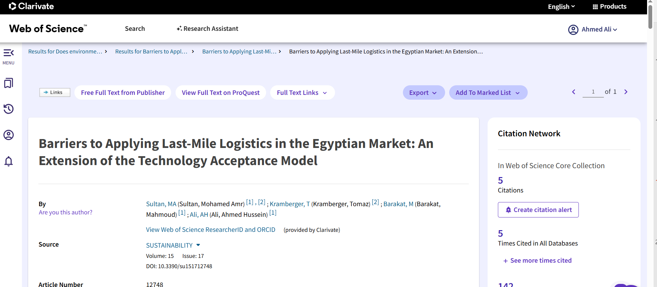
Contributions
Journal: Sustainability (SCOPUS Q1- Wos Q3) 2023
Contribution: This research will help enhance organisations’ performance in Egypt as a developing country and push towards applying environmental sustainability practices, as it introduces a tool to enhance customer satisfaction and reduce emissions by illustrating how last-mile logistics can be implemented. This is particularly important as last-mile logistics face some implementation barriers, especially in developing countries. In addition, it will help in extending the Technology acceptance model theory through conceptualising its abstract ideas with the research variables and applying it in a different context.
Barriers to Applying Last-mile Logistics in the Egyptian Market: An Extension of the Technology Acceptance Model

Slide 14
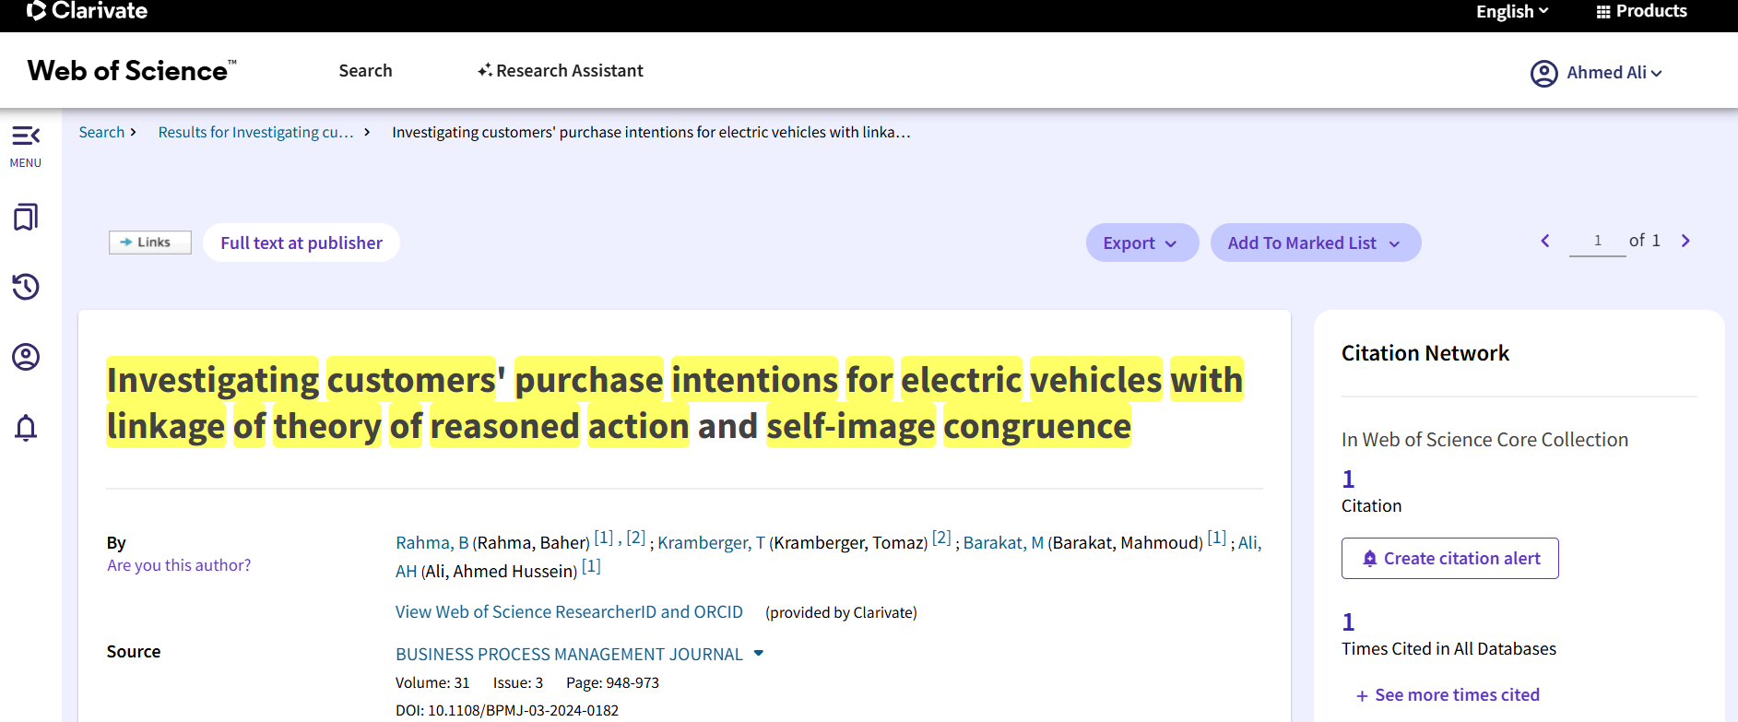
Contributions
Journal: Business Process Management Journal (SCOPUS Q1- Wos Q1) 2025
Investigating Customers’ Purchase Intentions for Electric Vehicles With Linkage of Theory of Reasoned Action and Self-image Congruence
Contribution: This study provides key theoretical and practical contributions by integrating the Theory of Reasoned Action and Self-Congruity Theory to explain how green trust, price sensitivity, reliability, and self-image congruence influence EV purchase intention, with financial self-efficacy as a moderating factor. The research extends current models by addressing the combined impact of rational and self-image factors on consumer decisions. Practically, it guides policymakers and marketers to focus on incentives, trust-building, and aligning EVs with consumer self-image to effectively drive purchase intention.

Slide 15
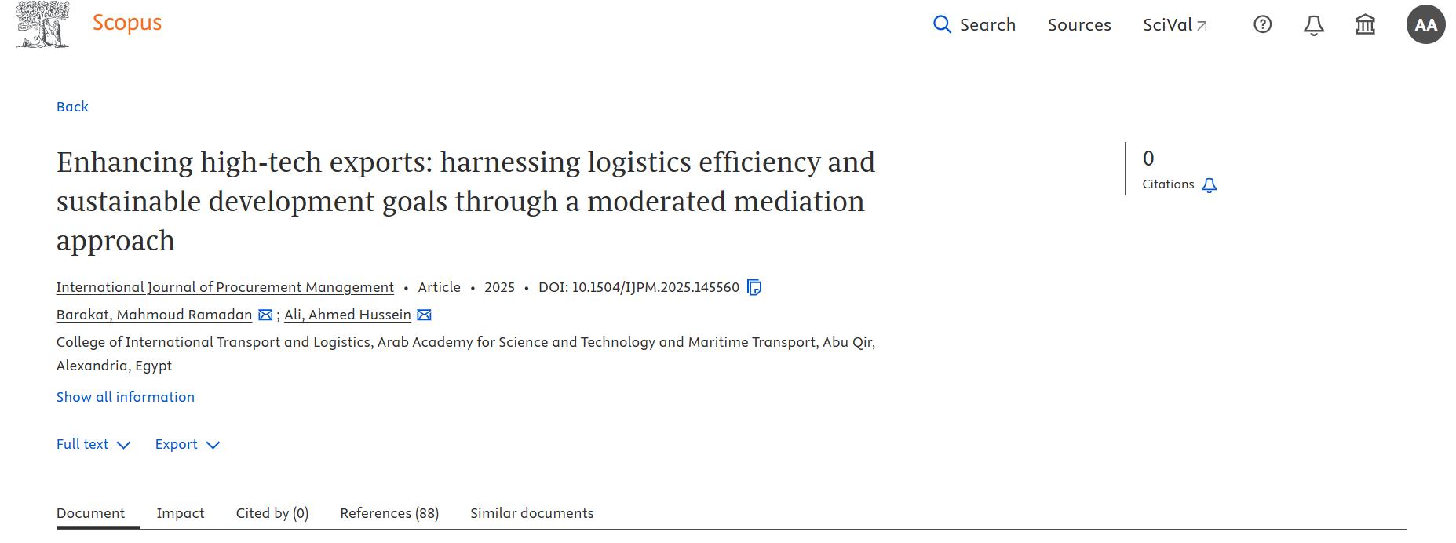
Contributions
Journal: International journal of Procurement management (SCOPUS Q3) 2025
Enhancing High-tech Exports: Harnessing Logistics
Efficiency and Sustainable Development Goals
Through a Moderated Mediation Approach
This study shows that combining logistics performance with R&D strengthens high-tech exports and supports sustainability. It extends Transaction Cost Theory (TCT) and Knowledge-Based View (KBV) at the country level, highlighting that investing in both logistics and R&D can reduce costs, boost competitiveness, and help achieve the UN 2030 agenda.

Slide 16

Future Research Directions
Incorporation of artificial intelligence, big data, and the Internet of Things for real-time sustainability monitoring.
The impact of sharing economy approaches on sustainable supply chain performance.
Sustainability performance management in circular supply chains.
Influence of new legislation on sustainability key performance indicators and reporting.

Slide 17
Artificial Intelligence Applications
Maersk
Application: Using artificial intelligence to analyse millions of maritime data points and predict container shipment delays.
Technology: Machine learning algorithms to analyse weather conditions, vessel movements, and global crises.
Benefit: Improving the accuracy of delivery schedules and reducing shipment delays.
Walmart
Application: Drones are used to deliver products such as medicines and groceries.
Technology: Artificial intelligence controls the drone’s flight path and ensures its safety.
Benefit: Faster delivery compared to traditional methods, while reducing traffic congestion and emissions.

Slide 18
Future Research Directions…..Cont.
Longitudinal research to evaluate the long-term effects of sustainability.
Assessing supply chain resilience in the context of sustainability goals.
The impact of green hydrogen implementation on the transformation of sustainable logistics and energy supply chains.

Slide 19
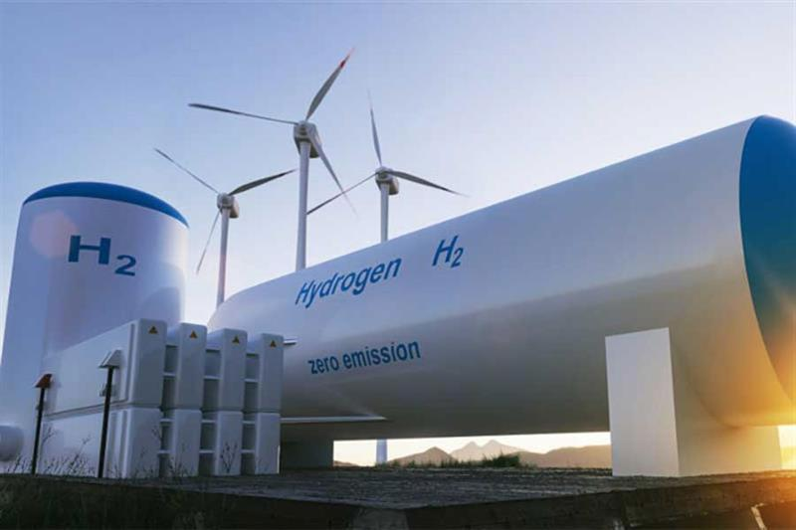
Contemporary Practices in Supply Chain Sustainability Management
Green Hydrogen
Hydrogen produced using renewable energy sources like wind, solar, or hydropower—into various sectors and energy systems (Bhandari and Adhikari 2024).
Adoption Areas (Beckford, Jackson-Johns et al. 2023):
Hydrogen-powered vehicles, including trucks, ships, and drones, facilitate zero-emission logistics.
Industrial Processes: It will be used to support cleaner and more sustainable industrial activities.
Notes:
To produce 2.3 billion tonnes of hydrogen each year, we would need about 20.5 billion cubic meters of fresh water per year.
Liquid Organic Hydrogen Carrier

Slide 20

Egyptian Government Actions Supporting Green Hydrogen
Green Hydrogen Law (2024):
Tax incentives, investment support, and VAT exemptions for green hydrogen projects.
National Green Hydrogen Council:
Established in 2023, Coordinates project planning and policy implementation.
National Hydrogen Strategy:
Aims to produce 1.5M tons by 2030 and 5.8M tons by 2040.
.

Slide 21
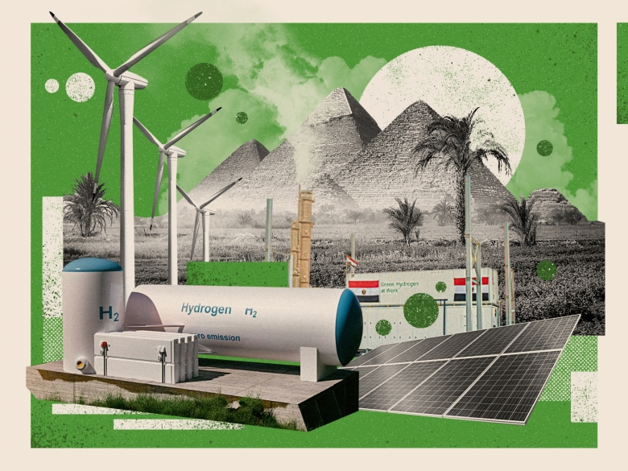
Egyptian Government Actions Supporting Green Hydrogen….Cont.
International Partnerships:
14 major MoUs signed in order to produce the Green Hydrogen.
Infrastructure Development:
Hydrogen hubs, desalination plants, and export facilities in key zones.

Slide 22
Contemporary Practices in Supply Chain Sustainability Management
Circular Supply Chains
The integration of Circular Economy (CE) into Supply Chain Management (SCM) has been termed circular supply chain in the literature (Calzolari et al,2022).
“Circular supply chain management applies circular principles to optimize supply networks by eliminating waste, reusing materials, and regenerating resources. It encompasses all stakeholders—from producers to consumers—throughout the full product or service lifetime, aiming for a sustainable, zero-waste system.” (Burke, Zhang et al. 2023).
Reducing waste, Reusing materials/products, Recycling, Remanufacturing, Designing for longevity and sustainability.
Notes:
Reducing waste, Reusing materials/products, Recycling, Remanufacturing, Designing for longevity and sustainability.

Slide 23
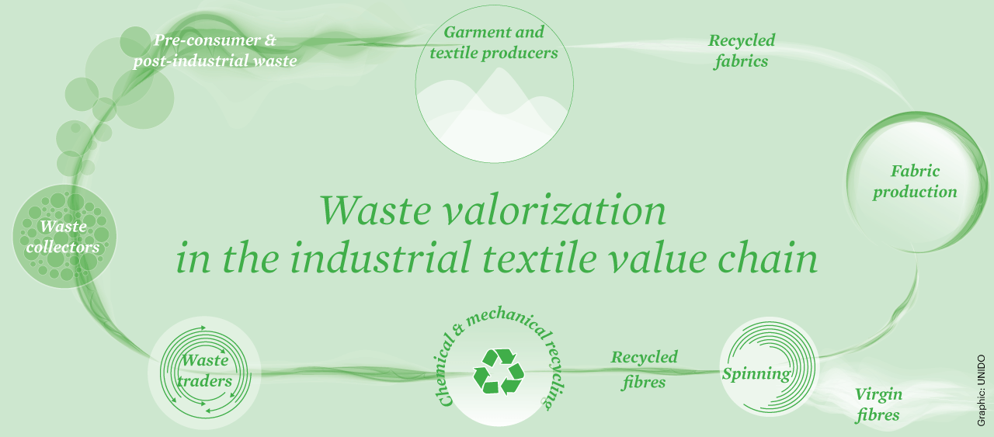
Egyptian Government Actions Supporting Circular Textiles
The government is integrating circular economy principles into national plans, like Egypt Vision 2030.
The government established the Textile Industries Council in 2022.
Egypt partners with the EU, United Nations Industrial Development Organization (UNIDO), access technical support and funding for sustainable industry initiatives.
Notes:
1. Pilot Projects & Technology Transfer
Through the UNIDO–EU SwitchMed MED TEST III initiative, Egypt has launched pilot projects (2019–2024) to:
Map 212,000 t/year of pre-consumer textile waste.
Demonstrate mechanical and chemical recycling.
Between June 2023 and April 2024, they reused textile scraps instead of throwing them away.
Develop a sustainable roadmap for circular textile value chains
A denim‑recycling pilot (RE.ACT) recycles post-industrial scraps into NE 30/1 yarns and garments, enhancing resource efficiency and collaboration across the full cotton value chain
Making Clothes Creates Waste: When "Garment and textile producers" (factories that make clothes and fabrics) cut out patterns, they have leftover scraps. This is called "Pre-consumer & post-industrial waste."
Collecting the Scraps: "Waste collectors" gather all these leftover scraps from the factories.
Sorting and Selling: The scraps are then sent to "Waste traders," who sort them and sell them to recycling companies.
Recycling the Fabric: The scraps go through "Chemical & mechanical recycling." This means they are broken down back into their basic form: tiny, raw fibers.
Mechanical recycling is like shredding the fabric.
Chemical recycling uses liquids to dissolve the fabric and extract new fibers.
Making New Thread: The "Recycled fibres" are then taken to a "Spinning" mill, where they are twisted together to create new thread or yarn.
Creating New Fabric: This new thread is used for "Fabric production," where it is woven or knitted into large sheets of "Recycled fabrics." Sometimes, they mix in "Virgin fibres" (brand new, non-recycled fibers) to make the fabric stronger.
Closing the Loop: This new, recycled fabric is sent back to the "Garment and textile producers" to make new clothes, and the cycle can start all over again.

Slide 24
List of References
Abdelsalam, R. A., Mohamed, M., Farag, H. E., & El-Saadany, E. F. (2024). Green hydrogen production plants: A techno-economic review. Energy Conversion and Management, 319, 118907.
Al‑Okaily, M., Younis, H., & Al‑Okaily, A. (2024). The impact of management practices and Industry 4.0 technologies on supply chain sustainability: A systematic review. Heliyon, 10(17).
Beckford, T., Jackson-Johns, G., Daoud, A., Finn, G., & Dowden, T. (2023). The Role of Hydrogen and Batteries in Delivering Net Zero in the UK by 2050.
Bhandari, R., & Adhikari, N. (2024). A comprehensive review on the role of hydrogen in renewable energy systems. International Journal of Hydrogen Energy, 82, 923-951.
Bianco, G., Bonvini, B., Bracco, S., Delfino, F., Laiolo, P., & Piazza, G. (2021). Key performance indicators for an energy community based on sustainable technologies. Sustainability, 13(16), 8789.
Burke, H., Zhang, A., & Wang, J. X. (2023). Integrating product design and supply chain management for a circular economy. Production Planning & Control, 34(11), 1097-1113.
Calzolari, T., Genovese, A., & Brint, A. (2022). Circular Economy indicators for supply chains: A systematic literature review. Environmental and Sustainability Indicators, 13, 100160.
Carter, C. R., & Rogers, D. S. (2008). A framework of sustainable supply chain management: moving toward new theory. International journal of physical distribution & logistics management, 38(5), 360-387.
Damtoft, N. F., van Liempd, D., & Lueg, R. (2025). Sustainability performance measurement–a framework for context-specific applications. Journal of Global Responsibility, 16(1), 162-201.

Slide 25
List of References …..Cont.
Hidalgo-Carvajal, D., Picanço-Rodrigues, V., Mejía-Argueta, C., & Salinas-Navarro, D. E. (2023). A systems perspective on social indicators for circular supply chains. In The Social Dimensions of the Circular Economy (pp. 27-52). Cham: Springer International Publishing.
Kourougianni, F., Arsalis, A., Olympios, A. V., Yiasoumas, G., Konstantinou, C., Papanastasiou, P., & Georghiou, G. E. (2024). A comprehensive review of green hydrogen energy systems. Renewable Energy, 120911.
Kumar, A., & Anbanandam, R. (2022). Assessment of environmental and social sustainability performance of the freight transportation industry: An index-based approach. Transport Policy, 124, 43-60.
Marrucci, L., Daddi, T., & Iraldo, F. (2024). Creating environmental performance indicators to assess corporate sustainability and reward employees. Ecological Indicators, 158, 111489.Singh, R. K. (2024). Impact of leadership, TQM and supply chain capabilities on sustainable supply chain performance: moderating role of institutional pressure. The TQM Journal.
Mishra, A., Dutta, P., Jayasankar, S., Jain, P., & Mathiyazhagan, K. (2023). A review of reverse logistics and closed-loop supply chains in the perspective of circular economy. Benchmarking: an international journal, 30(3), 975-1020.
Yu, H., Zahidi, I., Chow, M. F., Liang, D., & Madsen, D. Ø. (2024). Reimagining resources policy: Synergizing mining waste utilization for sustainable construction practices. Journal of Cleaner Production, 464, 142795

Slide 26


