Slide 1
Los Angeles
Media Studies Trip

Slide 2
LAIOK, the Los Angeles Institute of Knowledge, is located in the heart of Los Angeles, the entertainment capital of the world, where they invite students from around the globe to experience the rich cinematic and digital content culture.
Hands-on lectures by industry professionals at our center.
Visits and use of studios to create projects
Tours of iconic film sites, including:
  Sony Pictures Studios
  Paramount Pictures Studios
  Dolby Theatre
  TCL Chinese Theatre
  Hollywood Sign
  Hollywood Boulevard and its Walk of Fame

Slide 3
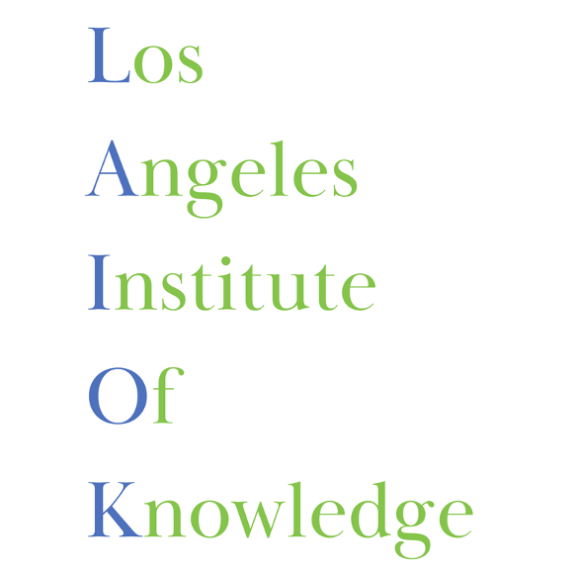
Schedule

Slide 4


Day 1 (Saturday)
Day 2 (Sunday)
Arrival to Los Angeles International Airport
Meet and greet
Bus to hotel - HI Los Angeles Santa Monica Hostel
Short walking distance to beach and center where lectures will be held
Free day
  Recommended: Experience the beautiful beaches and vibrant culture of Santa Monica and Malibu, including the movie-famous Santa Monica Pier

Slide 5
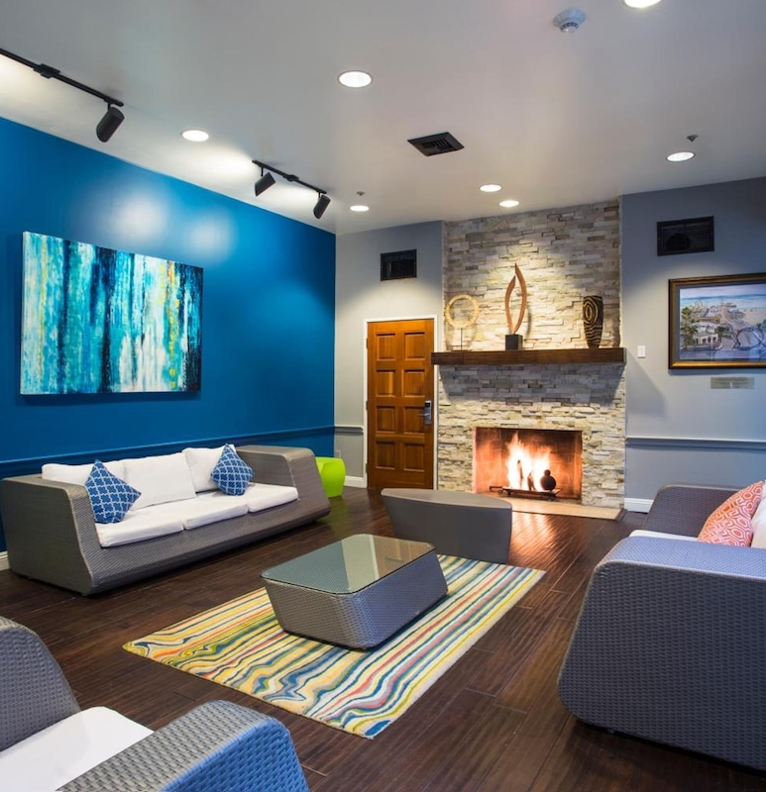
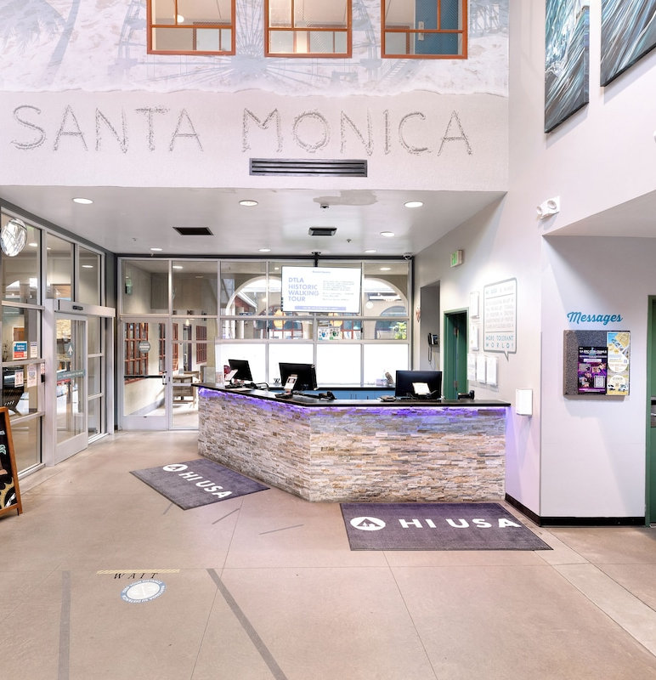

Slide 6
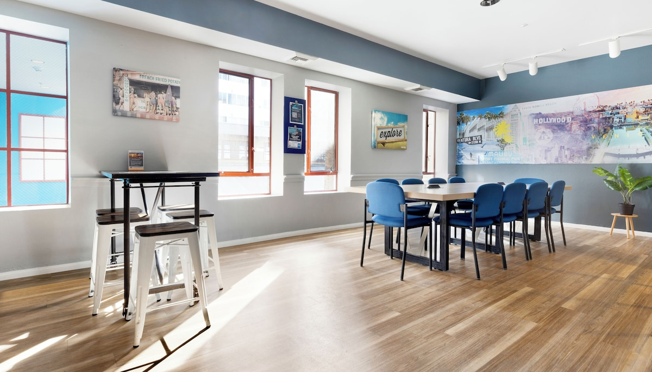
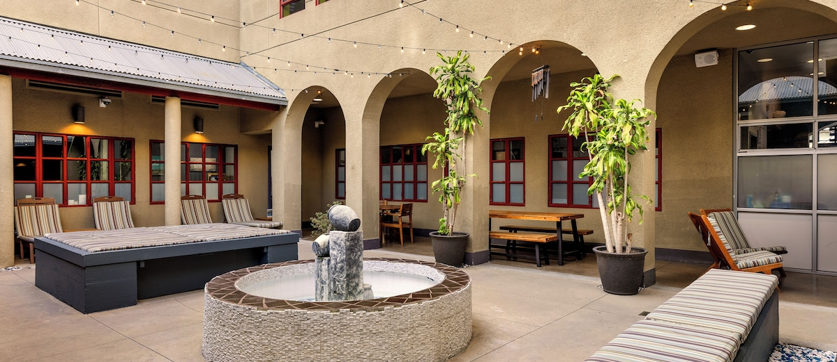
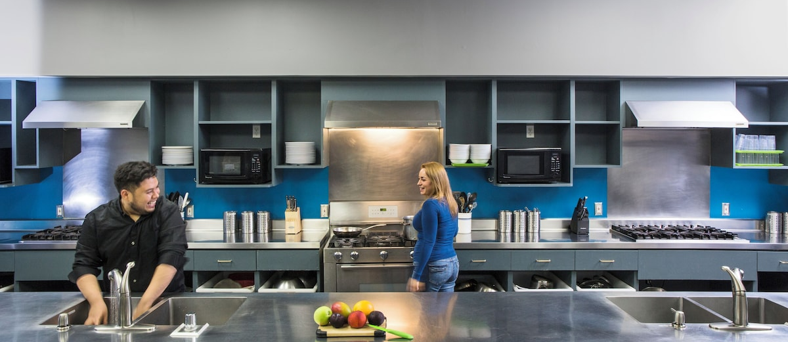
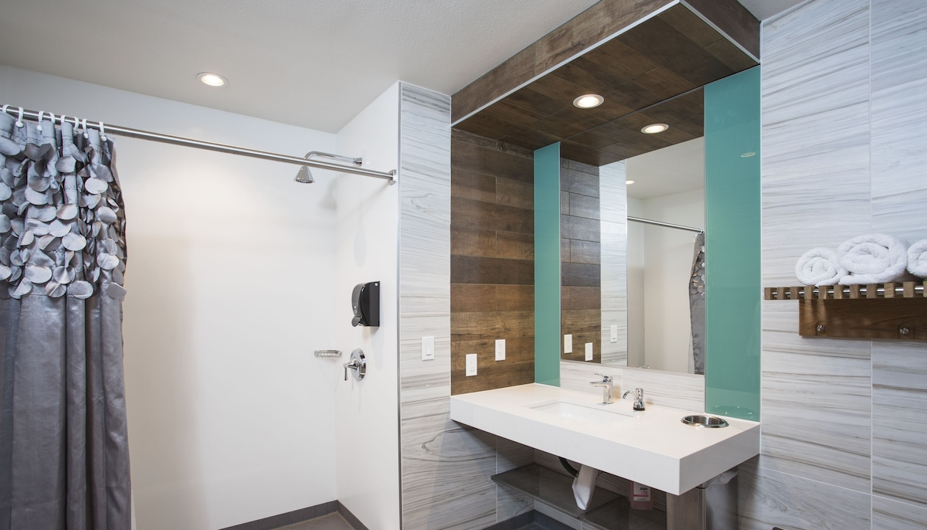

Slide 7
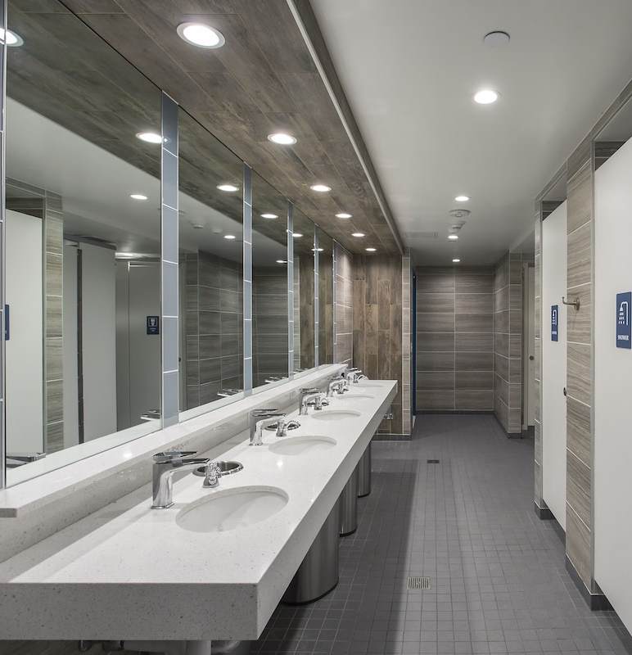
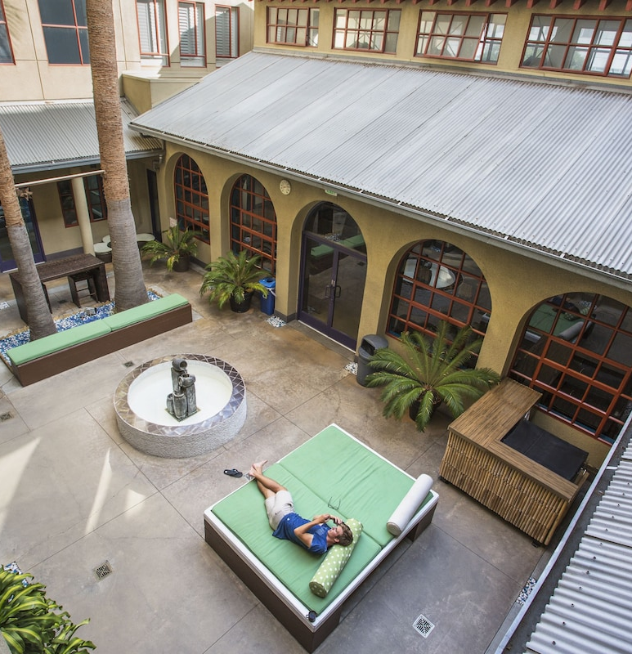

Slide 8
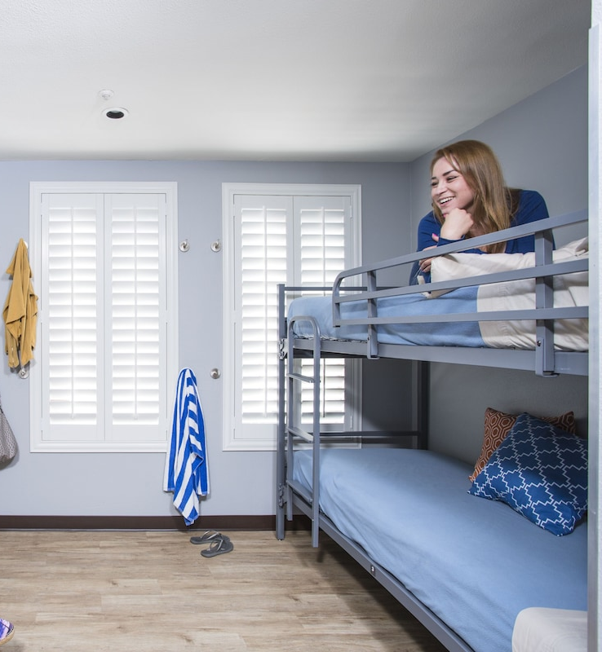
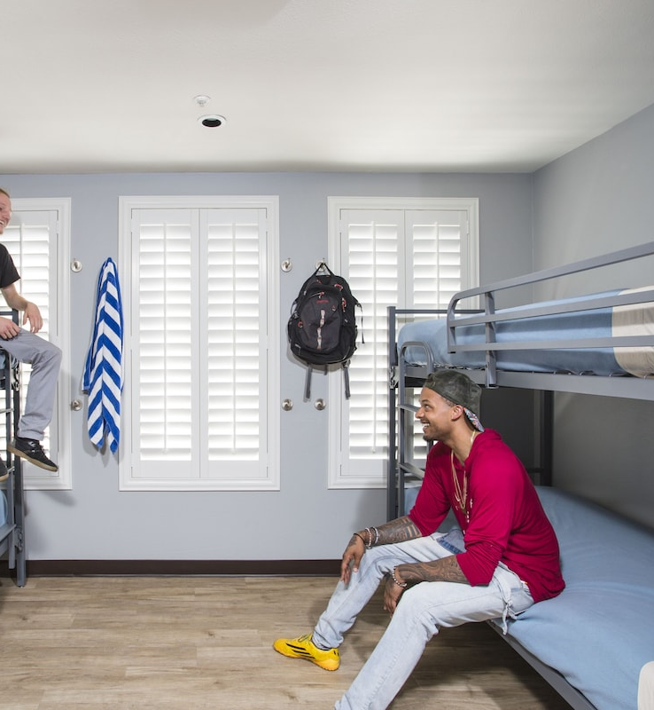

Slide 9
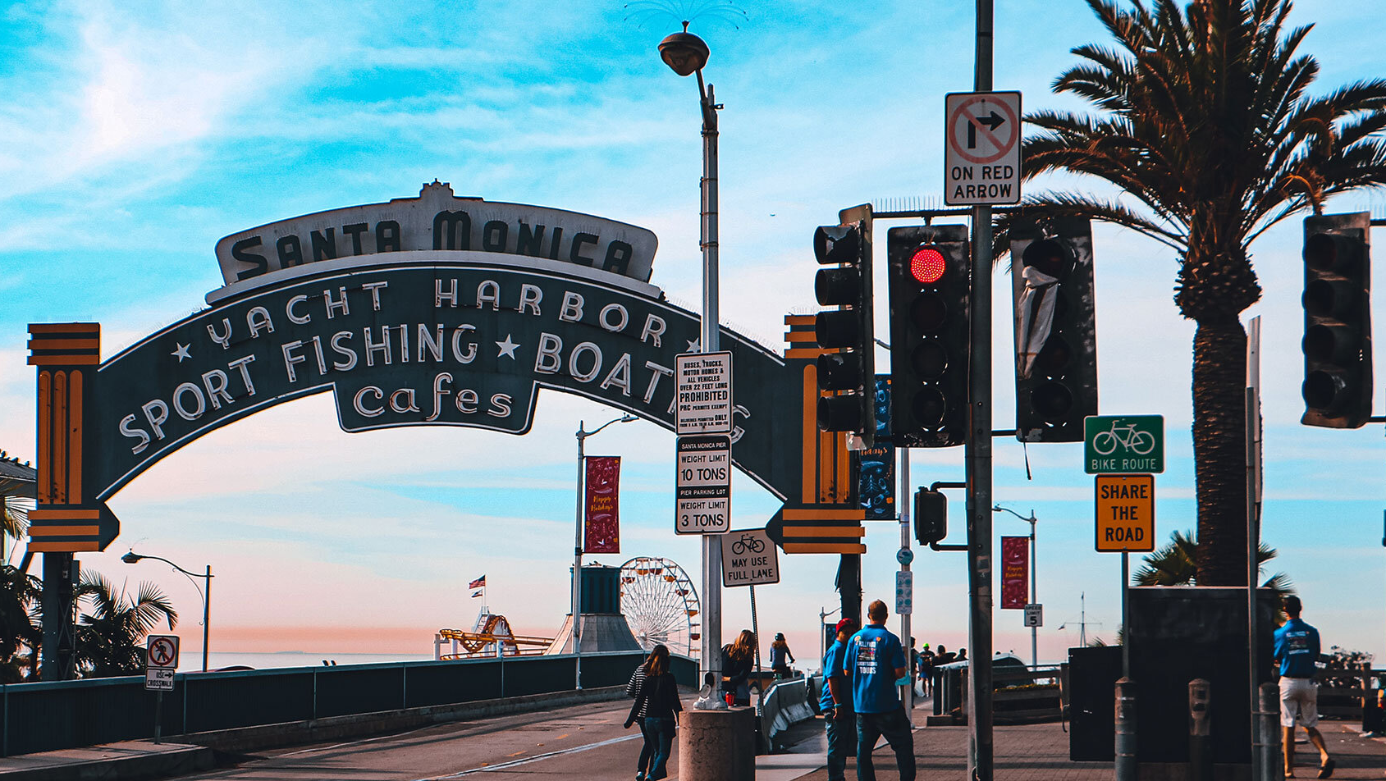

Slide 10
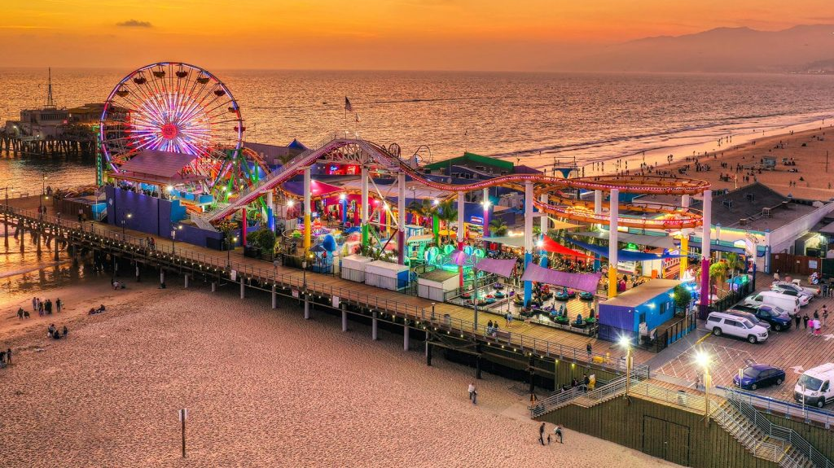

Slide 11

Day 3 (Monday)
Lecture at LAIOK Center in Santa Monica
First Lecture: Film Directing
  9 am – 2 pm
  Includes 1 hour lunch break
    Area includes various food, drink, and dessert locations such as Panda Express, El Pollo Loco, Pita House, Starbucks, Chick-fil-A, Fatburger, Subway, etc. that students can purchase from

Slide 12

Day 4 (Tuesday)
Guided tour of Sony Studios
  2 hour walking tour with a Sony expert
  Walk through the famed gates and you’re behind the scenes at one of the most historic and exciting studio lots in the world. Visit soundstages once home to iconic films like “The Wizard of Oz,” “Men in Black,” “Spider-Man,” “Wheel of Fortune,” and “Jeopardy!”
  Transportation provided
  Explore Culver City, “The Heart of Screenland”

Slide 13
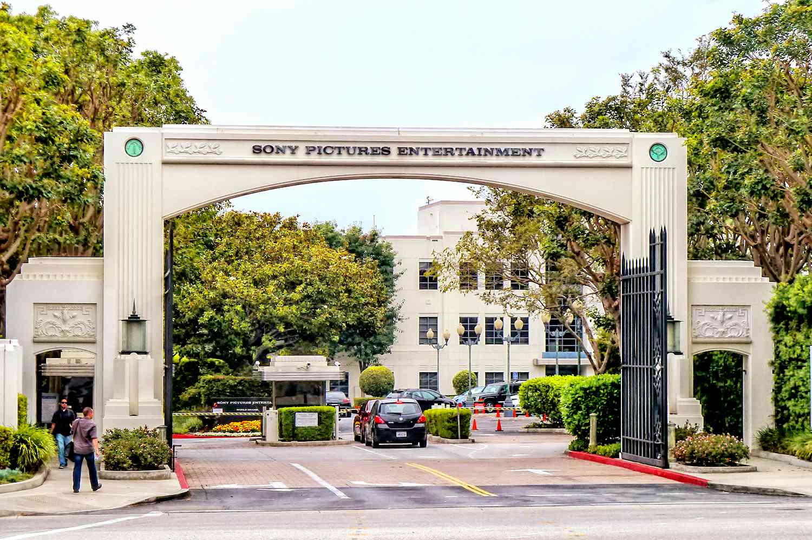

Slide 14
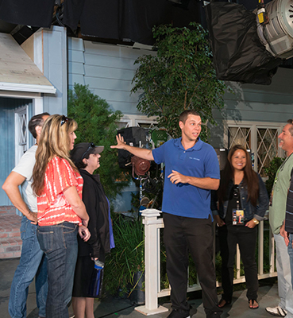
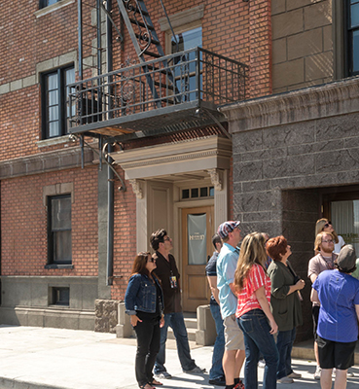

Slide 15

Day 5 (Wednesday)
Day 6 (Thursday)
Lecture at LAIOK Center in Santa Monica
Second Lecture: Digital Advertising
  9 am – 2 pm
  Includes 1 hour lunch break
Lab at a professional studio
  Practice filmmaking techniques and create projects

Slide 16
Day 7 (Friday)
Hollywood Sign and Hollywood Blvd
  Iconic locations, such as the Dolby Theatre, Walk of Fame, TCL Chinese Theatre, and many more
  Transportation provided

Slide 17
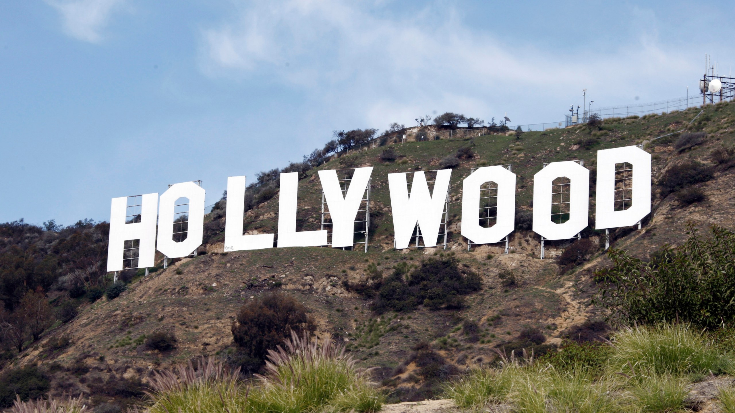

Slide 18
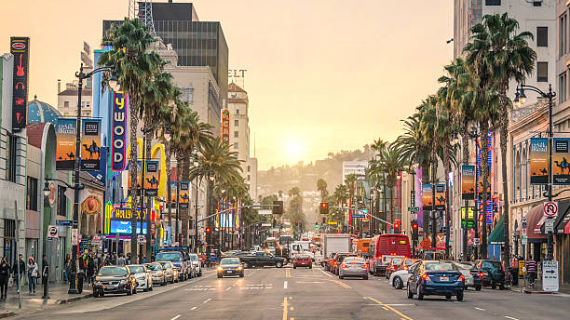

Slide 19
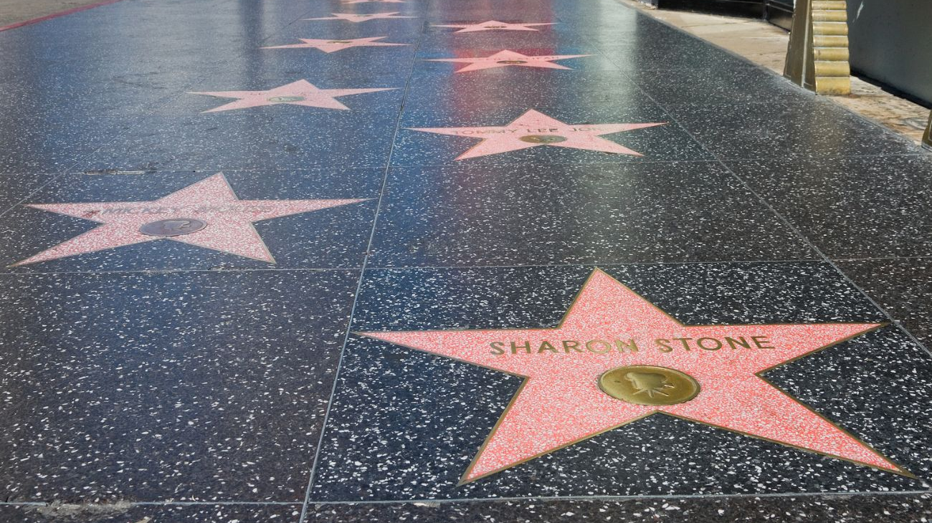

Slide 20
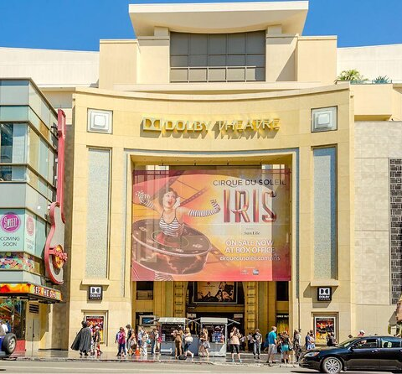
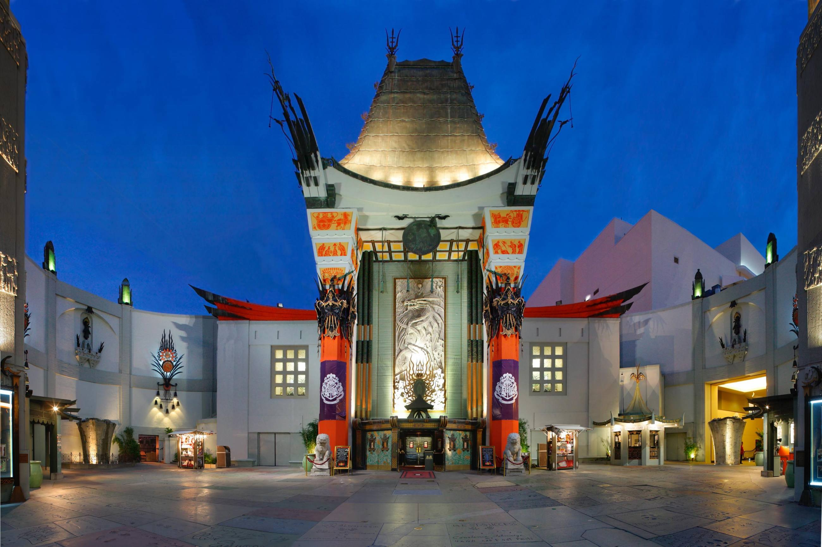
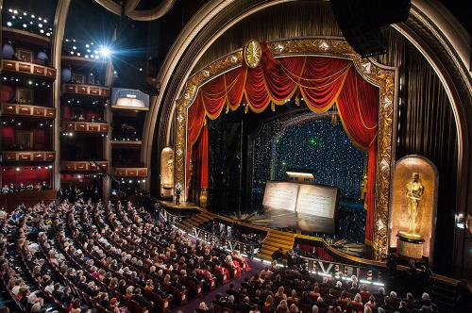

Slide 21

Day 8 (Saturday)
Bus Tour to Citadel Outlets
  Shop at LA’s premium outlet destination with Guess, Michael Kors, Nike, Calvin Klein, and so much more at great prices
  Transportation provided

Slide 22
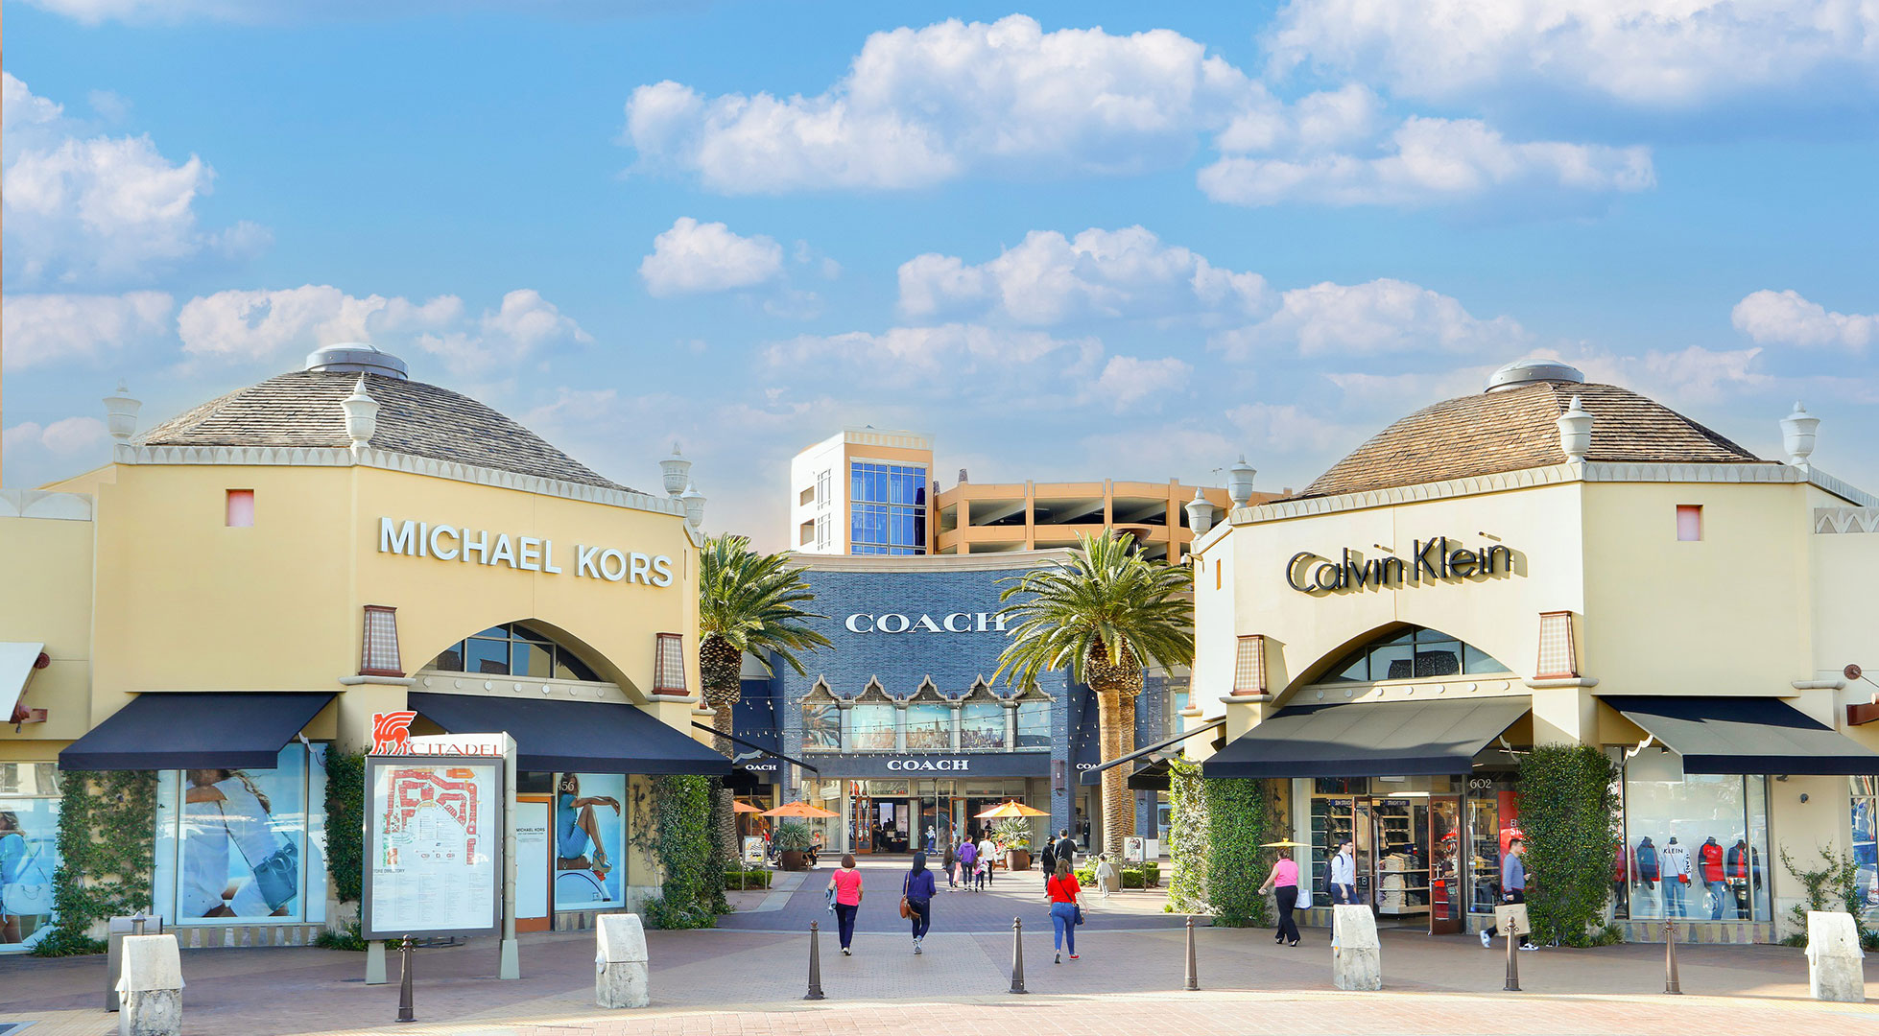

Slide 23
Day 9 (Sunday)
Free day
  Recommended: Visit Universal Studios, Disneyland, Six Flags, or Knott’s Berry Farm to experience the true thrills of LA

Slide 24
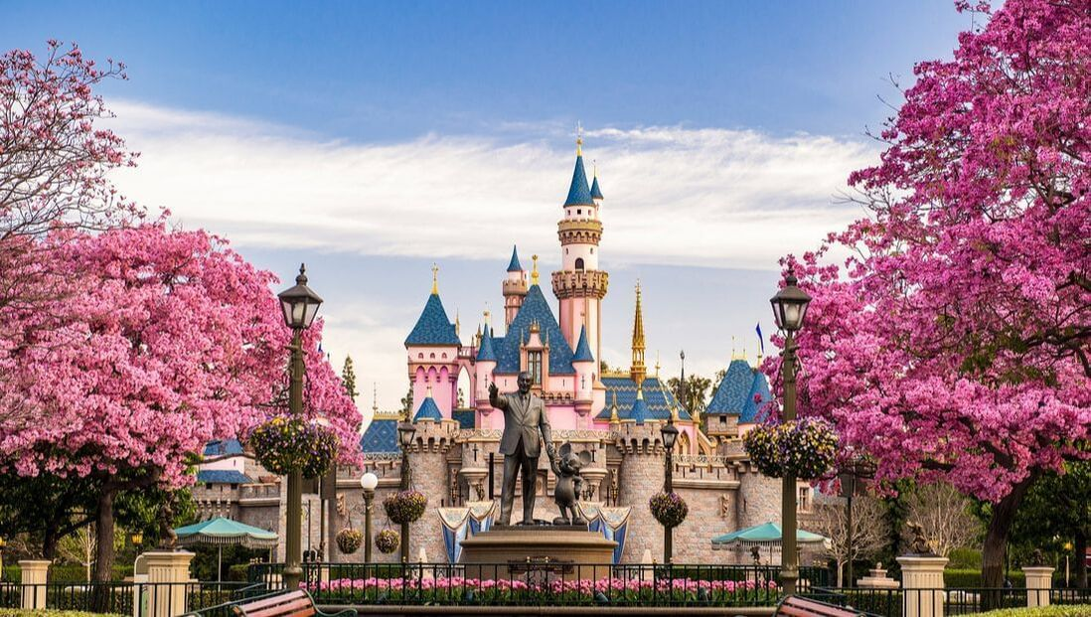

Slide 25
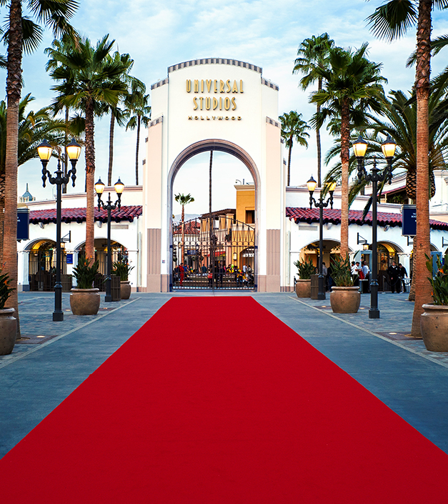
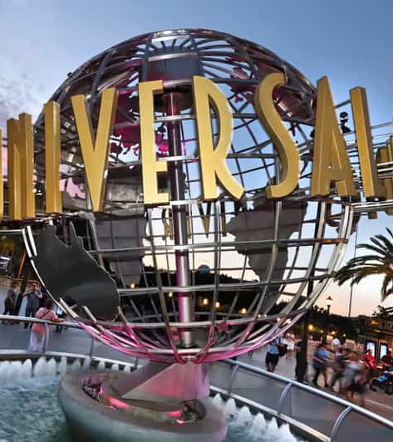

Slide 26
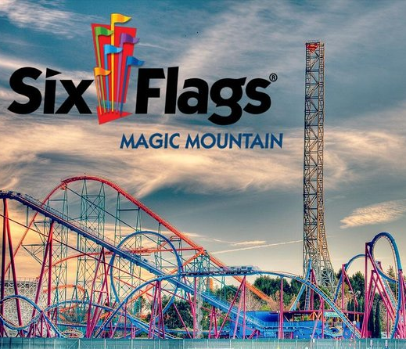
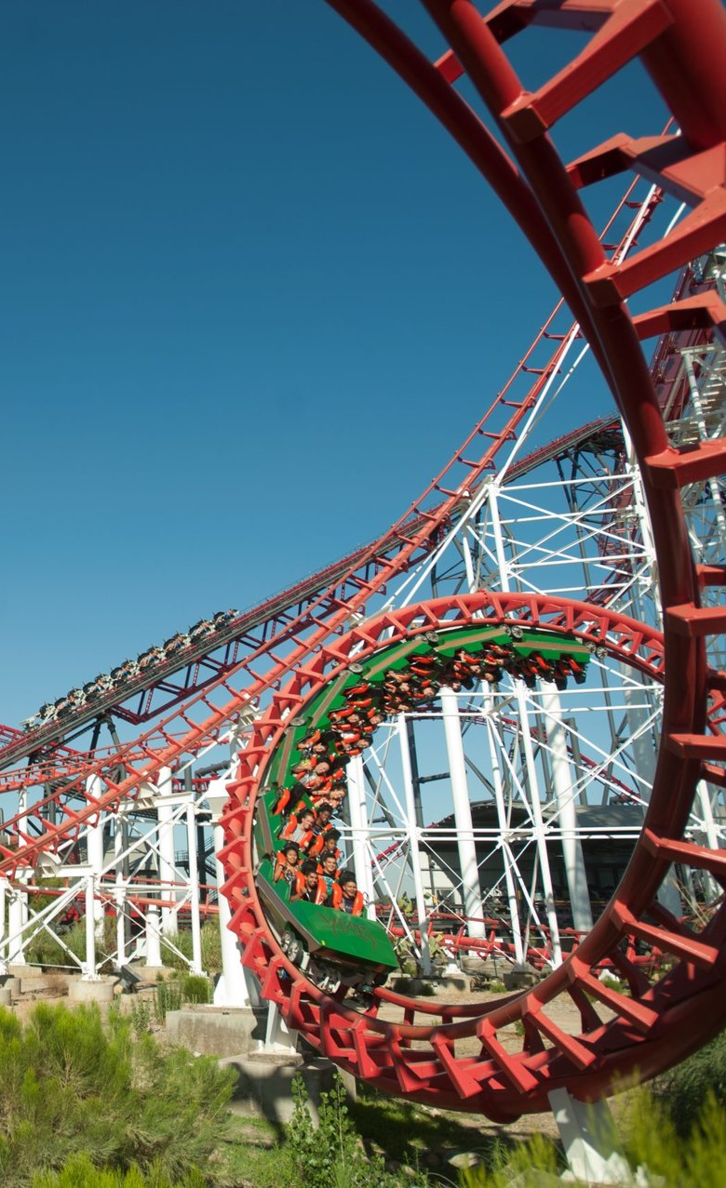

Slide 27

Day 10 (Monday)
Day 11 (Tuesday)
Lecture at LAIOK Center in Santa Monica
Third Lecture: Cinematography Techniques
  9 am – 2 pm
  Includes 1 hour lunch break
Visit to UCLA
  One of the top 30 universities in the world, UCLA is renowned for its exceptional academic programs.
  Walking tour of campus with expert guide
Explore Westwood Village

Slide 28
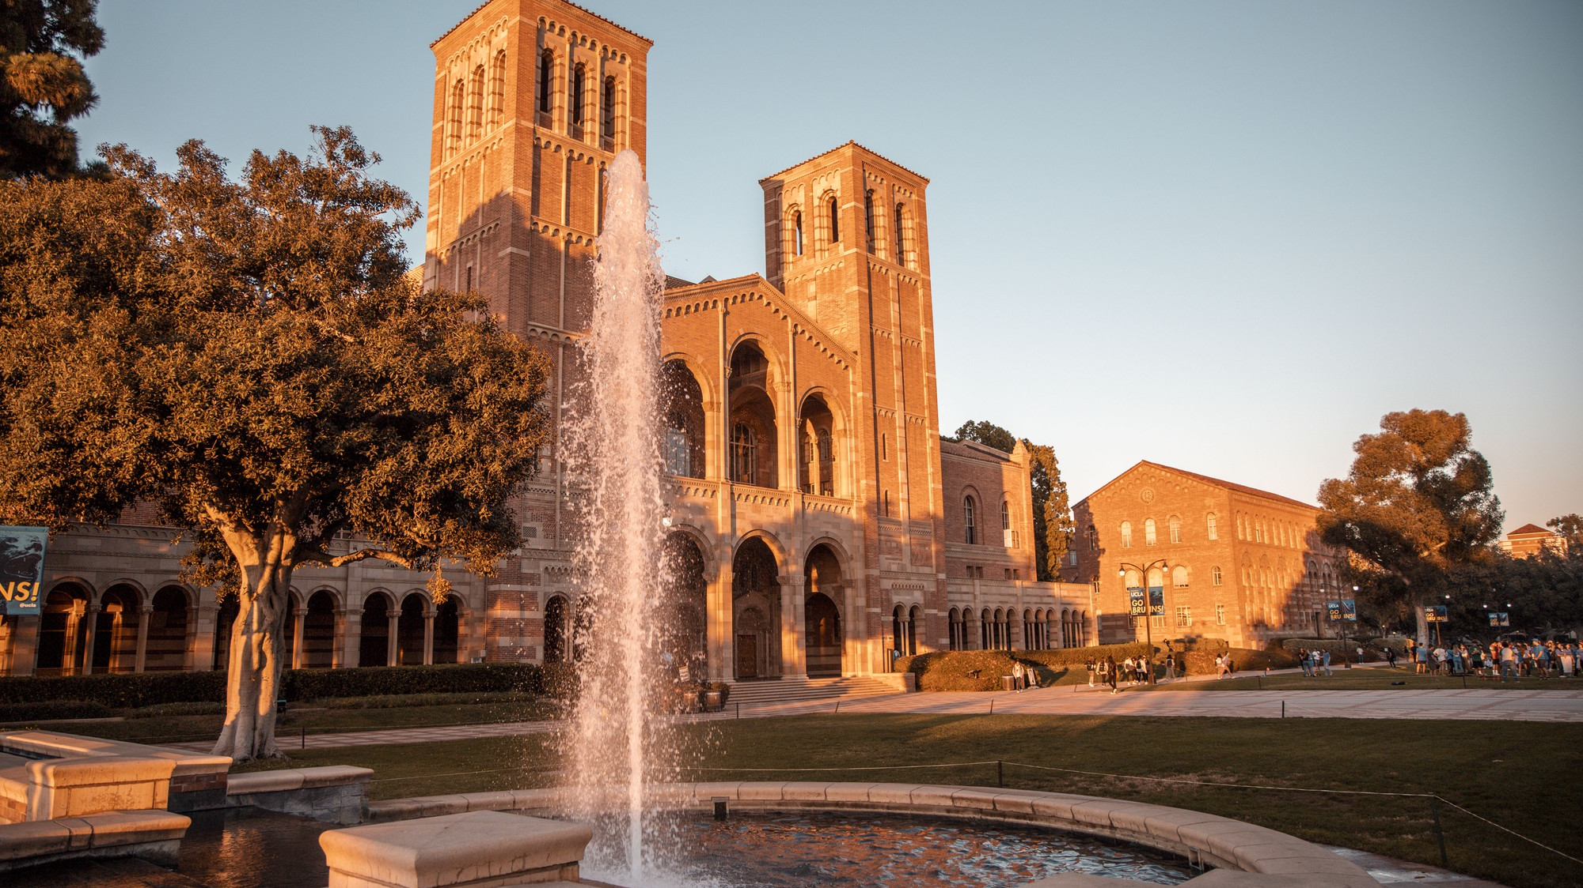

Slide 29
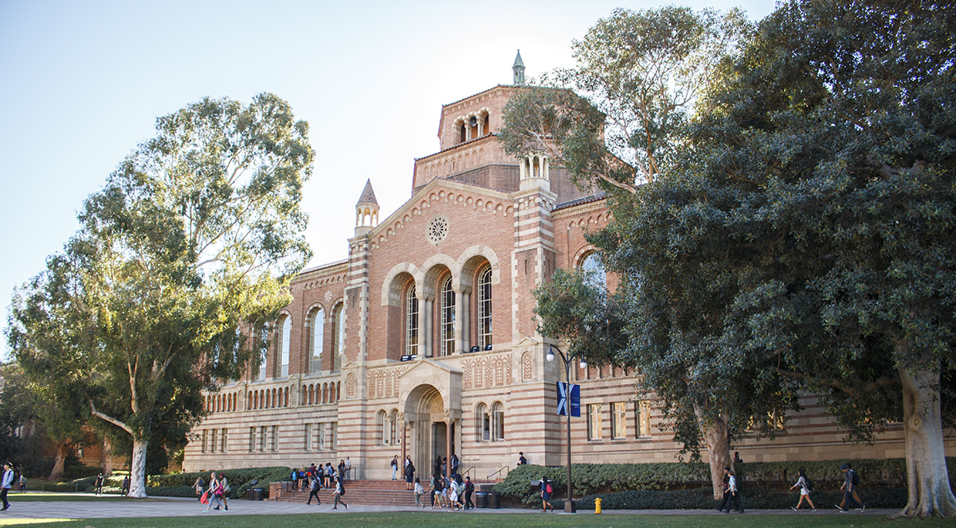

Slide 30
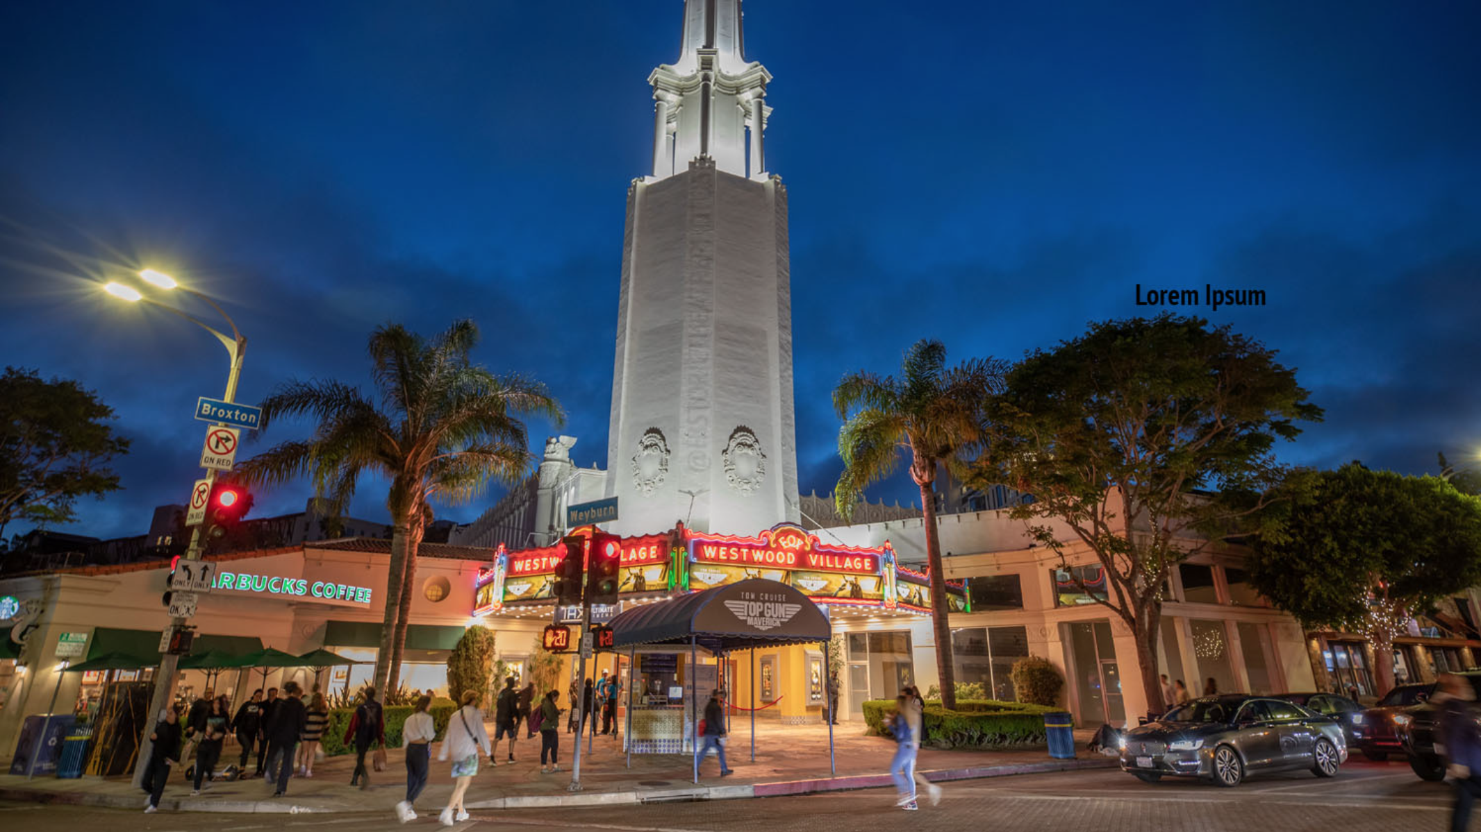
Westwood Village

Slide 31
Day 12 (Wednesday)
Day 13 (Thursday)
Lecture at LAIOK Center in Santa Monica
Fourth Lecture: AI Use and Innovations in Media
  9 am – 2 pm
  Includes 1 hour lunch break
Lab at a professional studio
  Practice filmmaking techniques and create projects
Students will receive a Certificate of Completion, signifying completion of training hours

Slide 32

Day 14 (Friday)
Day 15 (Saturday)
Guided tour of Paramount Pictures Studios
  2 hour cart tour with a Paramount Pictures expert
  Paramount's past and current achievements come together in this intimate, behind the scenes look at a true working studio.
  Transportation provided
Transportation to LAX airport and departure

Slide 33
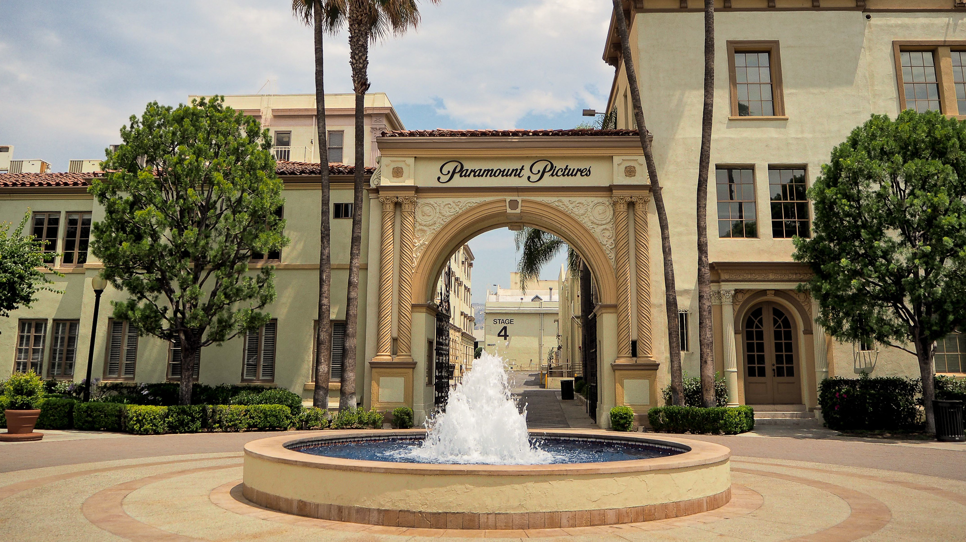

Slide 34
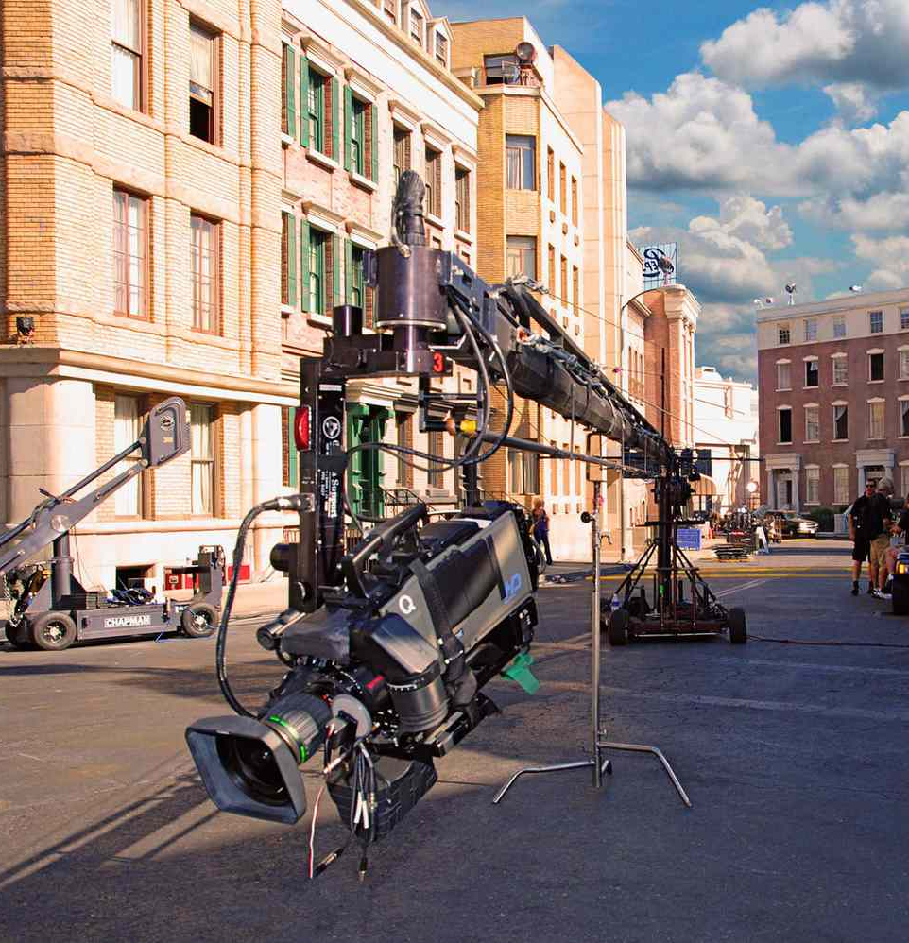
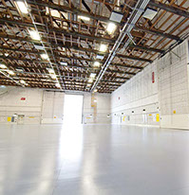

Slide 35
See you in LA!

